Slide 1
Module 04 – Configure & Manage Virtual Networking

Slide 2
Lesson 1 – Implement & Manage Virtual Networking

Slide 3
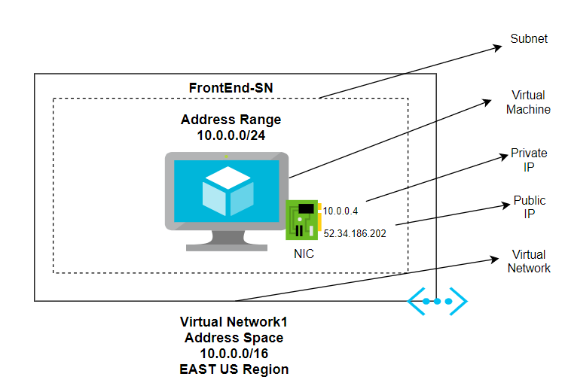
Implement and Manage Virtual Networking
Used to communicate Azure resources in the same VNet or across different ones (also across hybrid connections).
Uses the same terminology as a physical network (IPv4, IPv6, Subnetting, Public and Private IP addresses).
A VNet and its dependencies must be in the same Azure datacenter (region).
This can be created using the Azure Portal, PowerShell or CLI commands, REST API, and SDKs.

Slide 4
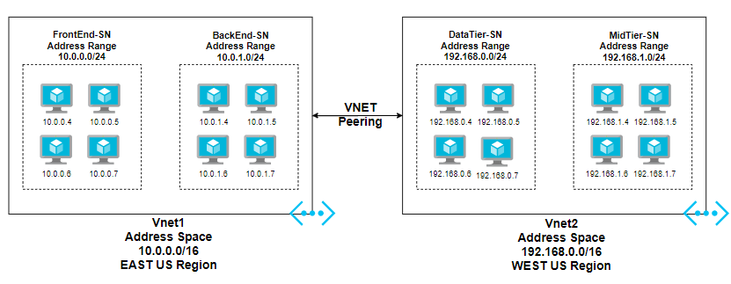
Create and Configure VNet Peering
Allows configuration of VNet-to-VNet connection with high performance, and better security by using the internal Azure backbone network.
Regional (VNets in the same Azure Datacenter) and Global (VNets in different Datacenters).
The only requirement is to avoid overlapping address spaces between source and destination VNets.

Slide 5
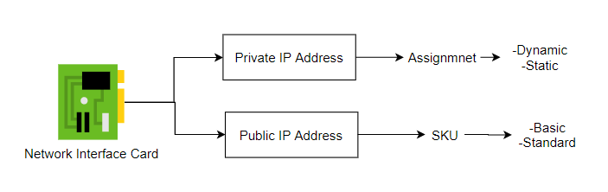
Configure Private and Public IP Addresses
A private IP address (static or dynamic) is used to communicate network resources internally, either by resources within the same VNet or across different VNets using VNet peerings, VPN GWs, or ExpressRoute.
A public IP address is used to communicate to the public (internet) (this can be assigned dynamically or statically).
IP addresses can be assigned to Azure VMs, Load Balancers, and VPN Gateways.
The most common IP address association happens at the Network Interface Card level.

Slide 6
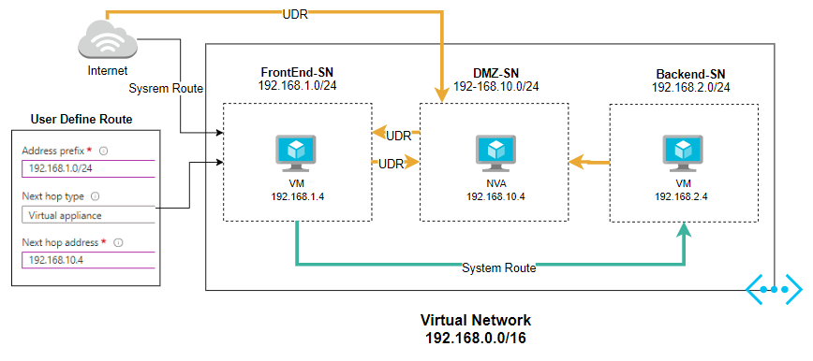
Network Routes, Interfaces, Subnets & VNets
Azure uses a default system route table to automatically send the traffic to the destination.
By using a User Defined Route, users can override the system route to force the traffic to a Network Virtual Appliance for traffic inspection.
The UDR need to be associated to a Subnet.

Slide 7
Lesson 2 – Configure Name Resolution

Slide 8
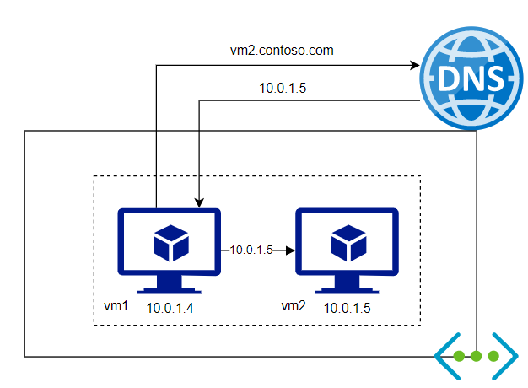
Configure Name Resolution
Name resolution allows users to use a DNS as a service to resolve FQDNs to private or public IPs.
Users can use a Private zone that allows them to resolve names to private IPs.
Alternatively, users can use a Public zone to resolve names to public IPs.

Slide 9
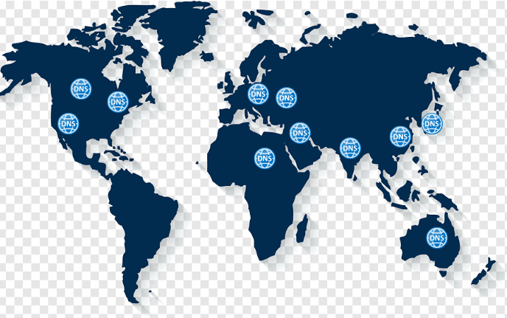
Azure DNS and Custom Settings
This is a hosting DNS service for name resolution.
Users can manage their DNS records in Azure.
Azure uses its global network of DNS servers that provide High Availability and the best performance.
No infrastructure is needed to manage and operate.
The same administration tools are used like any other Azure resource (Az portal, PowerShell or CLI commands, REST API and SDKs).

Slide 10
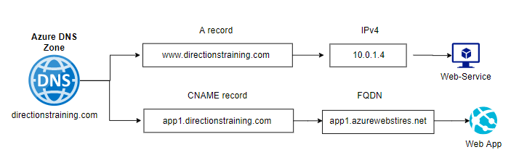
DNS Zones
Host records for a domain.
Multiple record types supported:
A, AAAA, MX, NS, SRV, SOA, CNAME, TXT, etc.
Users can use Domain delegation to Azure.

Slide 11
Lesson 3 – Secure Access to Virtual Networks

Slide 12
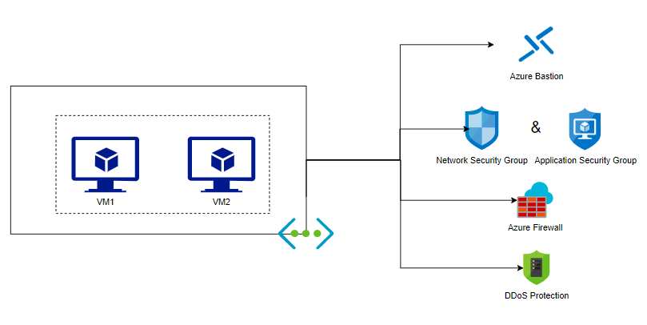
Secure Access to Virtual Networks
To protect remote access to VMs, users can use Azure Bastion which is a special Subnet in a VNet that usesa private IP address only to connect with RDP or SSH to VMS (there is no need to expose a public IP for remote administration).
With the Network Security Group and the Application Security Group, users can specify the type of traffic to allow or deny to their Virtual Network and the resources connected to it.

Slide 13
Secure Access to Virtual Networks
An Azure Firewall is a Firewall as a Service that is Highly Available, Scalable, and uses a static IP address.
Users can use it to manage the inbound/outbound traffic to their resources including hybrid environments.
Distributed Denial of Services provides attack mitigation that tries to overflow user services with traffic (with the purpose making their service unavailable to real traffic).

Slide 14
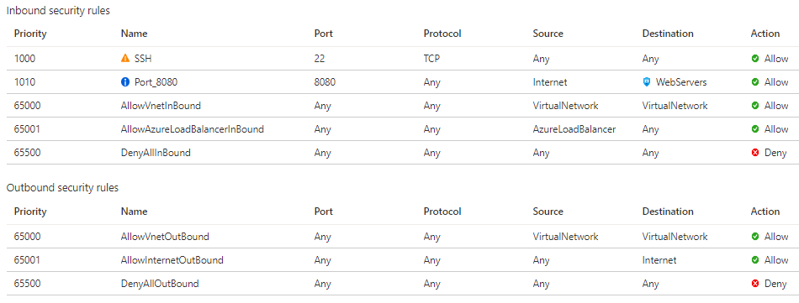
Network Security Rules
Network security rules in Azure can be configured through a Network Security Group, which is a resource to filter traffic inbound/outbound.
Users will configure priority, ports and ranges, protocol to filter, source/destination, and an action.
Default rules will be created and cannot be deleted or deactivated; however, users can override the default rules by configuring custom rules with a different priority than the default ones.
The smaller the number for priority, it will override the rules with a higher number.

Slide 15
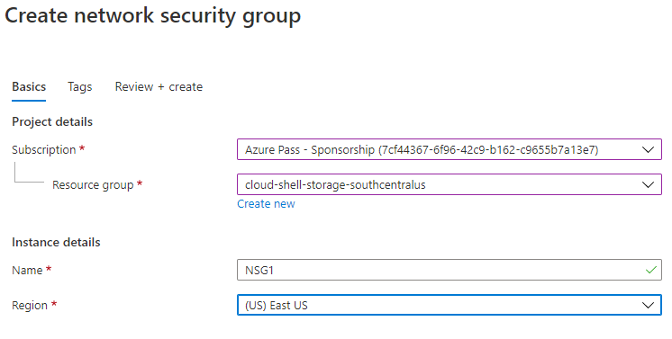
Create NSG
A network security is an Azure resource (no Azure cost); however, an active subscription is required.
NSGs need to be created in the same region as the Subnet or NIC to assign.
This can work in combination with Azure Firewall or 3rd party NGFWs.

Slide 16
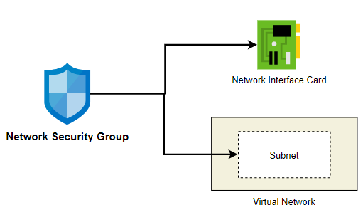
Associate NSG
A Network Security Group can be associated to Network Interface Cards or a Subnet in a VNet.
A single resource that uses both, like a VM, can have multiple NSGs. Be cautious with the association.
Users need to evaluate the effective rules by identifying how many NSGs there are and where the association is blocking or allowing traffic.
Users can use Network Watcher> NSG Flow logs to evaluate it or generate the Topology for that VNet.

Slide 17
Evaluate NSG Rules
When users configure an NSG, they can see a table with the information required by the rules. Users will find an Inbound and an Outbound section.
The rules require configuration of a Priority, Rule Name, Protocol Type, Port Number, Source and Destination Ips, and an Action (allow or deny).
The smaller number, the higher the priority.
A set of default rules for Inbound and Outbound are configured in any NSG, the custom rules and its priority will define the effective rules.
Network Security Group Configuration
Priority | Name | Protocol | Port | Source | Destination | Action
100 | Web | TCP | 80 | Internet | WebASG | Allow
200 | Data | TCP | 1443 | WebASF | DataASG | Allow
65000 | AllowVNetInBound | Any | Any | VirtualNetwork | VirtualNetwork | Allow
65001 | AllowAzureLBBound | Any | Any | AzureLoadBalancer | Any | Allow
65500 | DenyAllInBound | Any | Any | Any | Any | Deny

Slide 18
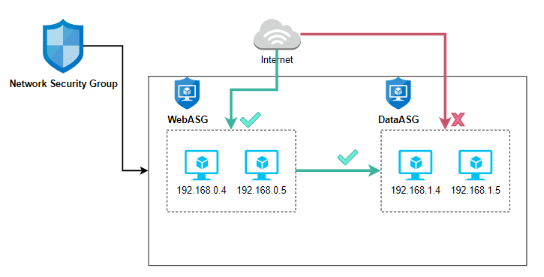
Application Security Groups
Network Security Group Configuration
Priority | Name | Protocol | Port | Source | Destination | Action
100 | Web | TCP | 80 | Internet | WebASG | Allow
200 | Data | TCP | 1443 | WebASF | DataASG | Allow
An Application Security Group (ASG) is an extension to an NSG.
An NSG uses Source and Destination and accepts individual IP addresses or IP ranges or Service tags that represents other Azure services.
An ASG is a group of contiguous or disparate IP addresses that users can register.
Then in the Source/Destination users can specify the previously created ASGs for the purpose of simplifying the NSG configuration.

Slide 19
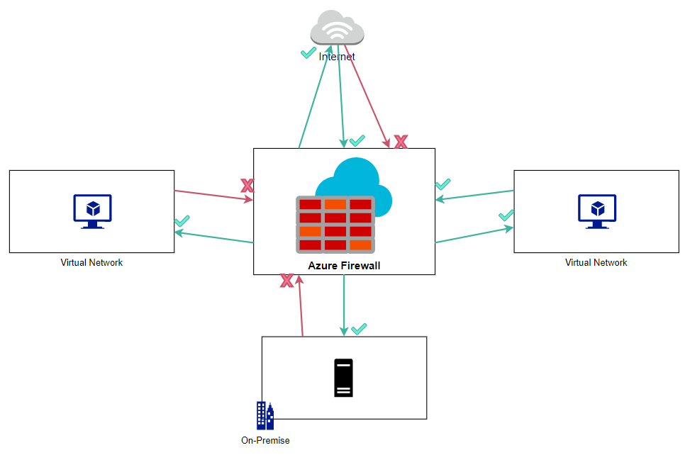
Azure Firewall
A Firewall as a Service Resource
No infrastructure or OS to manage
Comes with an SLA for HA up to 99.99%
This can scale dynamically based on resource demand
Stateful Firewall
Support Network Rules and FQDNs
URL filtering support
Users can use one Firewall to centralize all traffic
It is recommended that users create more than one for distributed deployments.

Slide 20
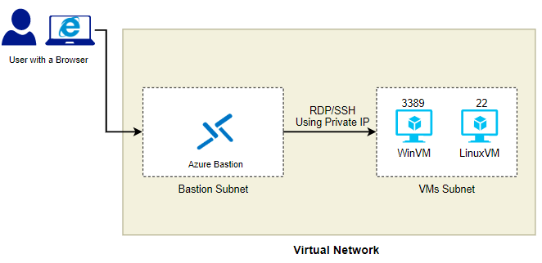
Azure Bastion Service
Azure Bastion creates a secure Subnet in the VNet that users want to connect remotely to Linux or Windows computers without the need to expose Azure VMs to the public.
By using a supported browser, users can request remote access to a VM within the same VNet through using private IP addresses.
Users can operate the computer remotely without using an RDP or SSH client.

Slide 21
Lesson 4 – Configure Load Balancing

Slide 22
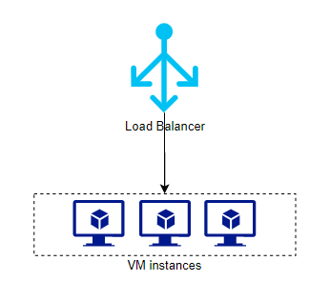
Configure Load Balancing
A load balancing solution in Azure complements the High Availability for Infrastructure as a Service (IaaS) resources.
Multiple LB solutions are available – which are regional or global LB solutions (that uses L4, L7 or DNS).
The simple definition – it’s an Azure resource that monitors more than one identical service to avoid single points of failures.
If one instance fails, the LB is monitoring those instances and automatically selects a healthy instance to send the incoming requests to (only for the instances that are running the service properly).

Slide 23
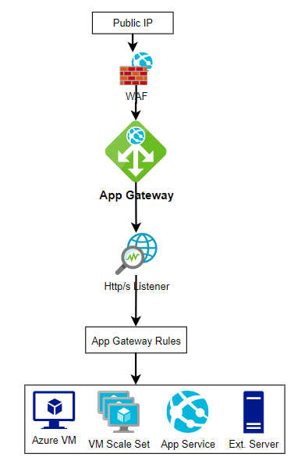
Application Gateway
An App Gateway is Layer 7 Load Balancing Solution.
It integrates a Web Application Firewall that uses a series of OWASP rules. This provides protection against common attacks.
Supports configuring multiple resource types (Azure VMs, Scale Sets, Web Apps, External Servers) on this backend pool.
Supports multi-domain and path-based routing.
A series of rules specifies the use of session affinity and conditions to monitor instance health and send the traffic to the appropriate instance.

Slide 24
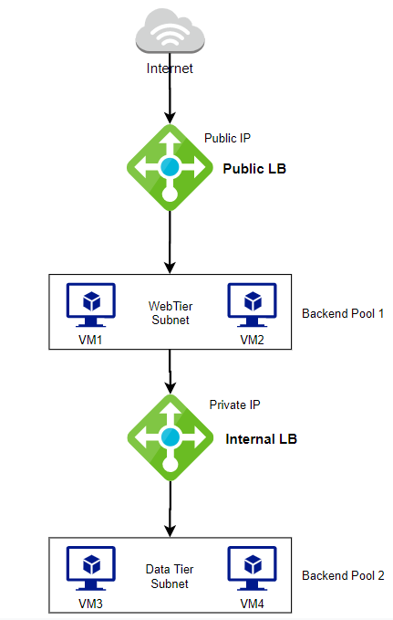
Internal and Public Load Balancer
An Azure LB is a Layer 4 (ports) regional Load Balancing Solution.
There are two versions, an Internal one that uses private IPs only and the Public one that manage the request that came from the internet.
A series of LB rules, Health Probes, Backend Pool and NAT Rules need to be configured.
Users can combine the two versions into a single solution (see diagram) to separate the tiers, the one that will manage the traffic from the public, and the one that needs to be more secure under a different subnet or VNet and under a different NSG restrictive rules.

Slide 25
Lesson 5 – Monitor Virtual Networking

Slide 26
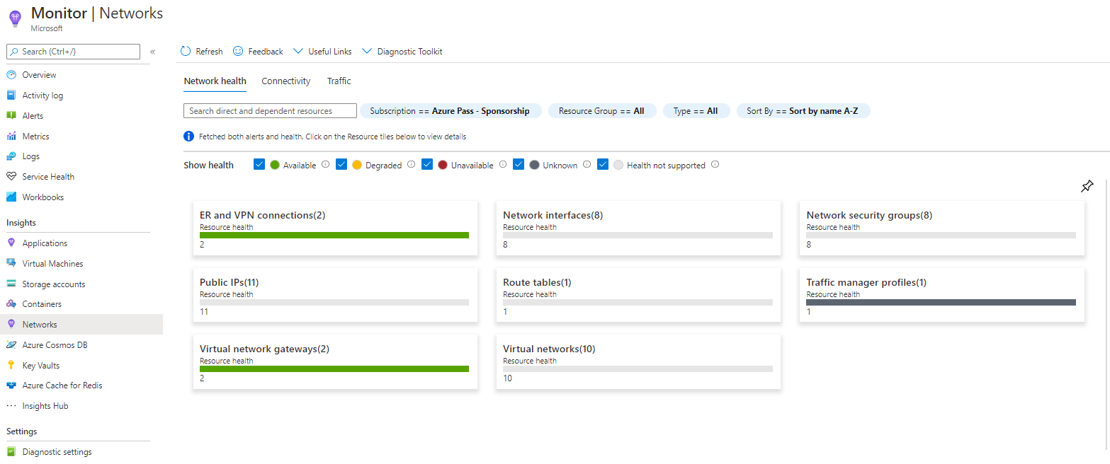
Monitor Virtual Networking
Azure Monitor service now includes a Networking section that centralizes the user network resources insights.
4 monitoring areas: Network Health and Metrics, Connectivity, Traffic and Diagnostic Toolkit.
Users can generate topologies and evaluate dependencies.
Users can also evaluate the traffic by accessing reports from NSGs.

Slide 27
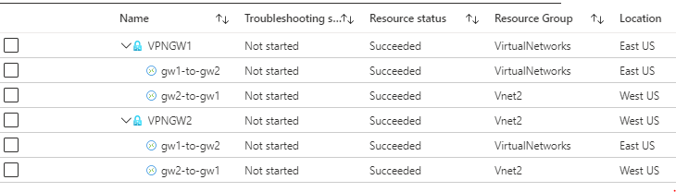
Monitor On-Premises Connectivity
To monitor on-premises connectivity, users can use Network Performance Monitor which requires creation of the NPM service on top of a Log Analytics Workspace.
Another option, whether users are using S2S VPN with Virtual Network Gateways or ExpressRoute, is using the Network Watcher> VPN Troubleshoot, which is an Azure included service that displays a list of VPN GWs and tunnels and their status. Users can start a Troubleshooting action at any time.

Slide 28
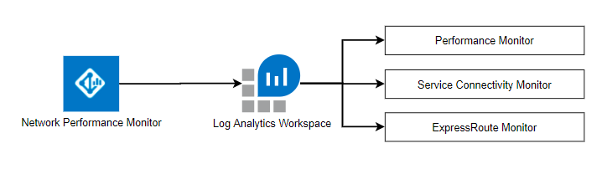
Network Performance Monitor
NPM its a hybrid network monitor solution.
It requires a Log Analytics Workspace which is a separate Azure resource.
Alerts can be configured from this source of analytics.
Provides 3 Main Capabilities:
Performance Monitor – to monitor cloud services and on premises connectivity
Service Connectivity Monitor – to monitor the user perspective to the service
ExpressRoute Monitor – to check end-to-end connectivity between Azure and the on-premise using ExpressRoute

Slide 29
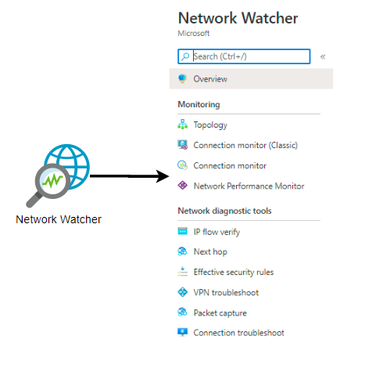
Network Watcher
Provides a set of diagnostic tools for IaaS network resources to find root cause and use the information to fix issues.
Users can generate a topology for a Virtual Network and its dependencies.
With IP flow, users can check network connectivity from a source to a destination.
With Next Hop, users can evaluate the routing paths for System routes or User Defined Routes.
VPN troubleshoot displays VPN devices and tunnels status.
With Packet Capture, users can create a file that can be used later to apply special tools to analyze traffic from a NIC.

Slide 30
Lesson 6 – Connect On Premises Network with AzureVirtual Networks

Slide 31
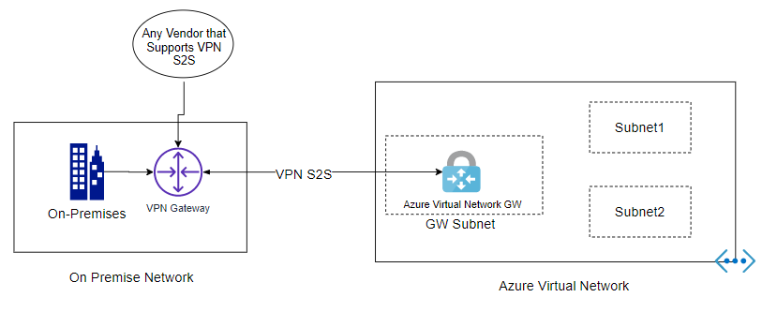
Connect On-Premises Network with Azure Virtual Networks
A Virtual Network Gateway is required to connect an on-premise network to an Azure Vnet
An Azure VPN GW can be connected to an on-premise VPN GW that supports IPSEC S2S protocols to create an encrypted tunnel.
There is a version of an Azure VPN GW for ExpressRoute connections.
In either case, the same Azure VPN GW is required.
The Azure Virtual Network GW needs to be connected to a VNet and requires a special Gateway Subnet to work properly.

Slide 32
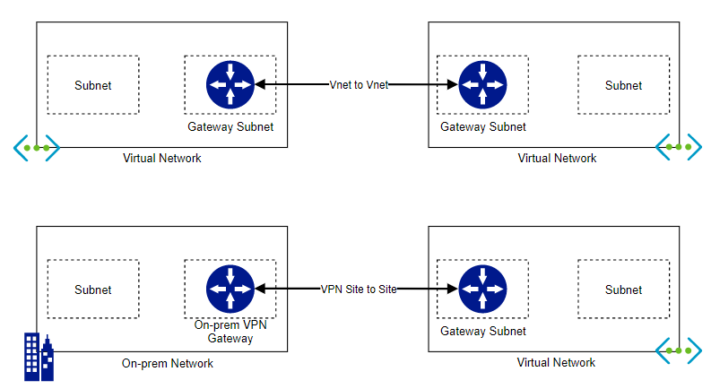
Azure VPN Gateway
The Azure Virtual Network Gateway can be used for 3 different types of connections:
VNet to VNet Connections – establish a link with 2 VNets in Azure.
VPN Site to Site – establish a secure connection from a VNet in Azure to a Network in the on-premise or another cloud.
ExpressRoute – requires association to the organization that is already subscribed to ExpressRoute, then users can use the Azure VPN GW to connect to Networks in the on-premise.

Slide 33
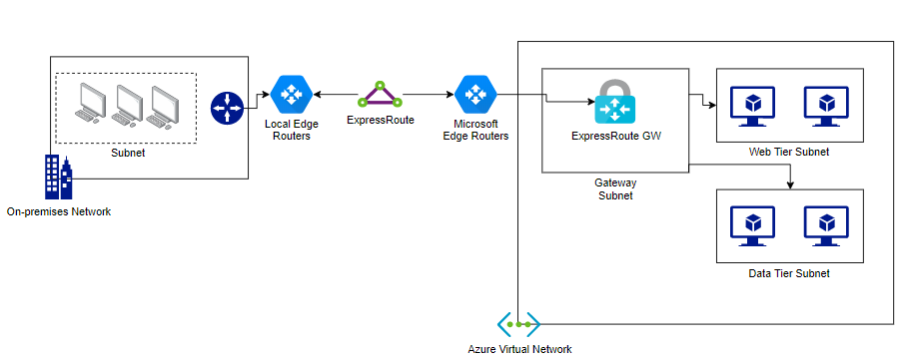
ExpressRoute
ExpressRoute is a special connection that a Connectivity Provider in the user’s area has that works in partnership with Microsoft to configure the infrastructure in their facilities to receive a private link (which is an extension to the Microsoft network).
No internet or public connections are required – internal communication and encryption are used by default.
There are different plans for the bandwidth (up to 10Gbps).

Slide 34
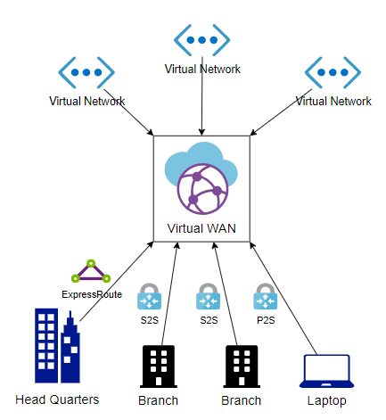
Azure Virtual WAN
Azure Virtual WAN is a resource that concentrates any type of connection supported in Azure for the purpose of simplifying the connectivity and troubleshooting process.
From Virtual WAN, users can create new connections (Peers, VPN S2S Tunnels, VPN P2S, ExpressRoute) to manage and troubleshoot connections.
The central hub allows transitivity between the endpoints.

